Slide 1
System Dependability
Ch 5
Professor AM Schilling

Slide 2
System FSM
Failure
UP
DOWN
Restoration

Slide 3
Some definitions
Availability: AKA “Uptime” when a system is able to perform and/or provide its intended service. Also known as “Service Accomplishment”
Interruption: AKA “Downtime” when a system is expected to deliver a service, but cannot.
Failure: the movement from Availability to Interruption
Restoration: the movement from Interruption to Availability
Reliability :

Slide 4
Planning for Failure
In a perfect world, we would have no failures, but the world is not perfect!
We measure the availability of a system by deriving metrics that describe about how long we can expect the system to be up.

Slide 5
Reliability
Reliability : the measure of uptime with respect to some time measure
Mean Time to Failure: How long before the system will fail
Annual Failure Rate: % devices expected to fail in a year for a given MTTFs

Slide 6
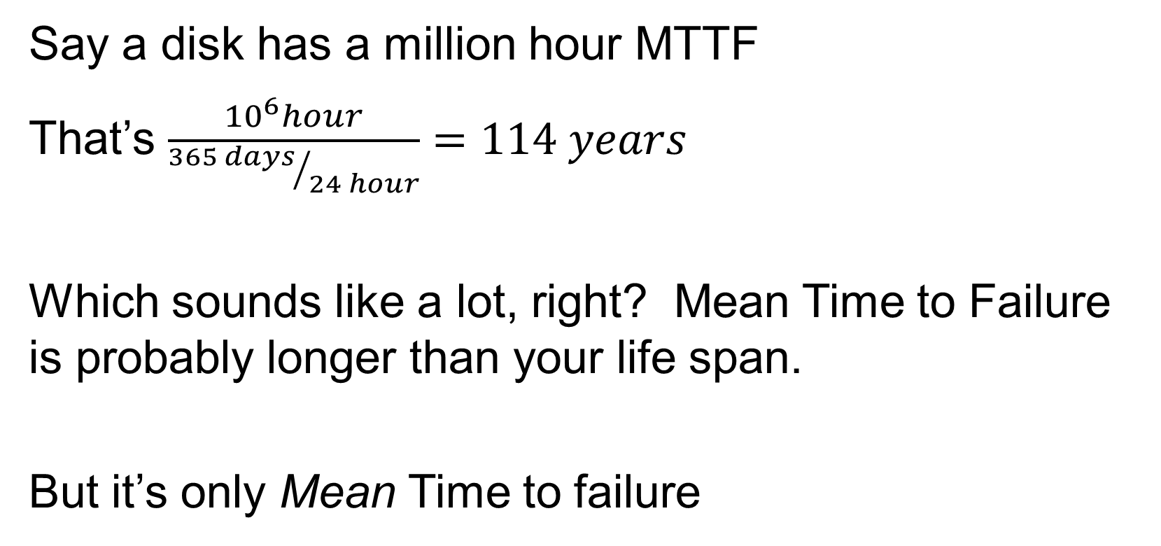
Practical Calculation
Say a disk has a million hour MTTF
That’s $\frac{{10}^{6}hour}{{365 days}/{24 hour}}=114 years$
Which sounds like a lot, right? Mean Time to Failure is probably longer than your life span.
But it’s only Mean Time to failure

Slide 7
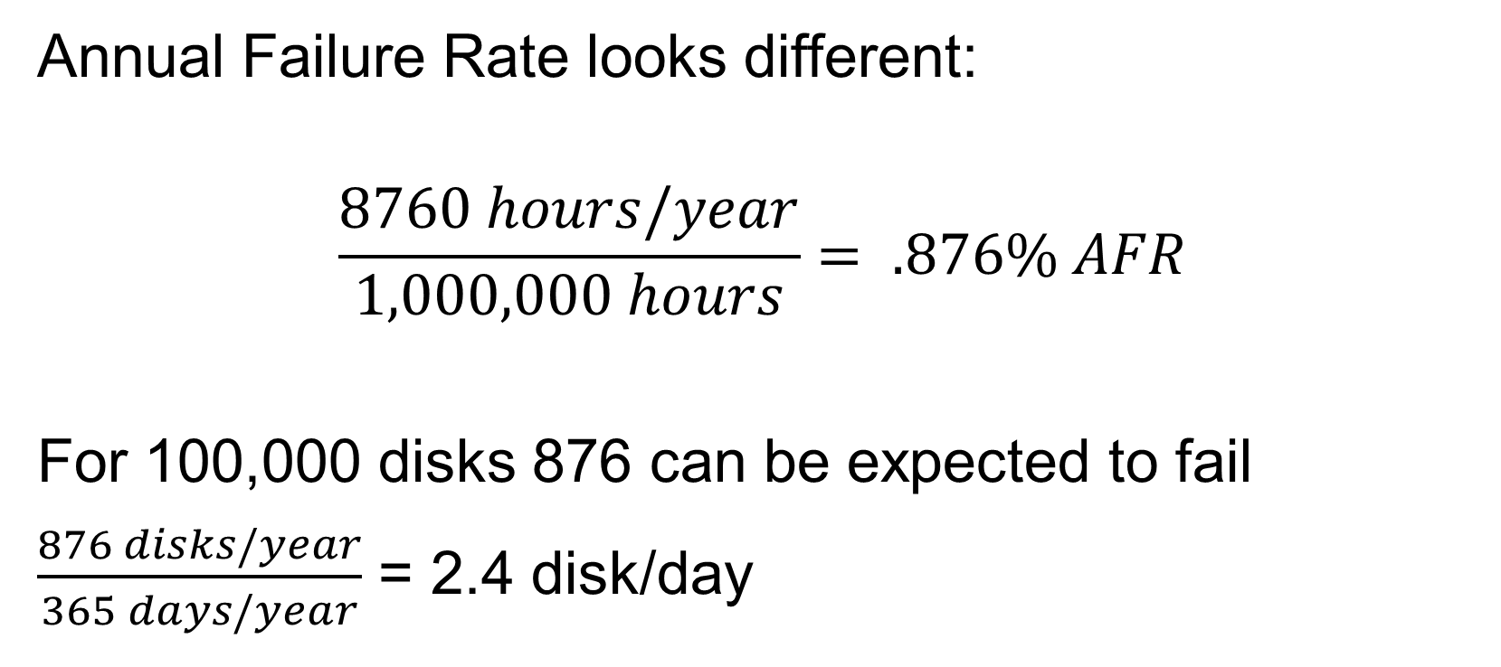
Practical and Realistic, now
Annual Failure Rate looks different:
$$\frac{8760 hours/year}{1,000,000 hours}= .876\% AFR$$
For 100,000 disks 876 can be expected to fail
$\frac{876 disks/year}{365 days/year}$ = 2.4 disk/day

Slide 8
Well, that was sobering….
….what do we do?
Plan for failure by attempting to increase MTTF
Isolate component failures so that they don’t cause a system failure
Introduce redundancy
Anticipate and possibly predict faults

Slide 9
Specifically:
Fault Avoidance: Preventing faults by construction either through software, hardware, or a combination
Fault Tolerance: Construct system so that it handles faults gracefully. For hardware, typically done via redundancy
Fault Forecasting: Familiarity with weaknesses of system allows a component to be replaced or maintained before failure

Slide 10
Error Detection - Parity
Parity describes the number of 1’s in a string of bits
Odd Parity – Odd number of 1’s
Even - Even number of 1’s
When a word is written to memory, an extra bit is written with it. This bit is set or unset to make the parity even

Slide 11
Parity Example
45₁₀ is represented as 101101
Even parity, so parity bit is 0
31₁₀ is represented as 011111
Odd parity, so parity bit is 1
When a word is read from memory, the parity bit is checked. If parity bit does not agree with bits read from memory, an error is detected.
What’s the weakness here?

Slide 12
Parity
45₁₀ is represented as 101101
We store 101101 0
If we read 100101 0 , we know an error has occurred
BUT…
If we read 11011 0, do we detect an error?

Slide 13
Hamming Code
Richard Hamming devised an error checking scheme in 1968 and was awarded the prestigious Turing Award
Hamming Distance: Minimum number of bits that are different between two bit patterns
011011 and 001111 has Hamming distance of 2

Slide 14
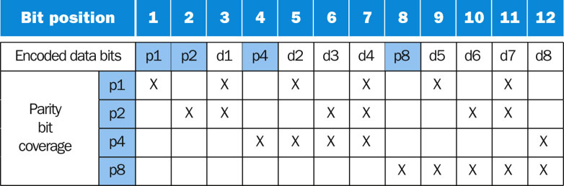
Hamming Code
In the Hamming Code, we embed the parity bits
Fig 5.24
Bit positions start at one and from the left.
All power of 2 positions are parity bits
All other bits are data

Slide 15
